Slide 1

Mobile App Development II COMP3097
Lecture 6
Przemyslaw Pawluk

Slide 2




Table of contents
Sensors
Publishing

Slide 3
Sensors
Process accelerometer, gyroscope, pedometer, and environment-related events.

Slide 4
CoreMotion
Core Motion reports motion- and environment-related data from the onboard hardware of iOS devices, including from the accelerometers and gyroscopes, and from the pedometer, magnetometer, and barometer.
You use this framework to access hardware-generated data so that you can use it in your app. For example, a game might use accelerometer and gyroscope data to control onscreen game behavior.

Slide 5
CoreMotion
Many services of this framework let you access both the raw values recorded by the hardware and a processed version of those values.
Processed values do not include forms of bias that might adversely affect how you use that data.
For example, a processed accelerometer value reflects only the acceleration caused by the user and not the acceleration caused by gravity.

Slide 6
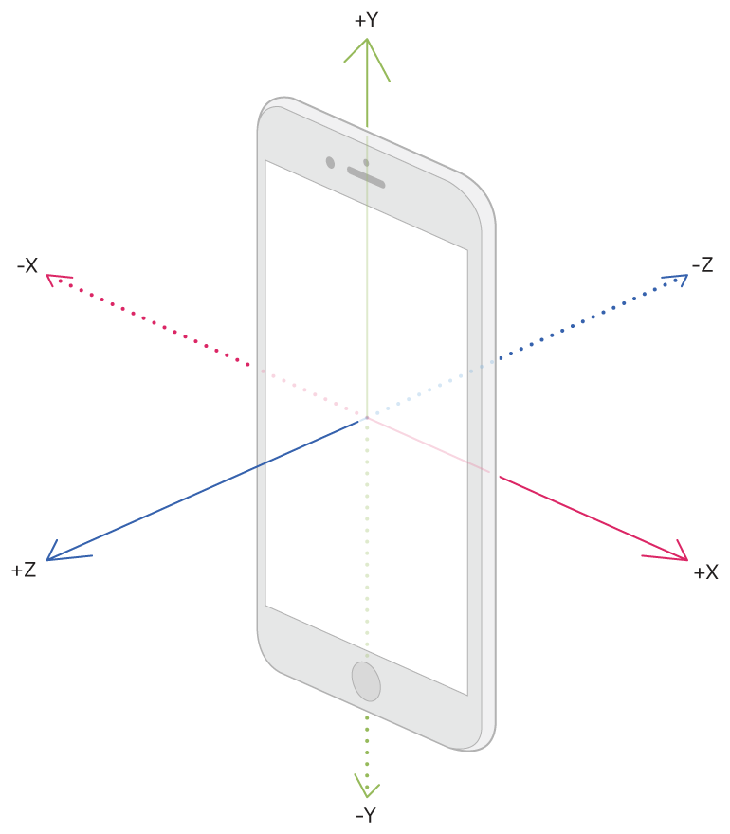
Motion
An accelerometer measures changes in velocity along one axis. All iOS devices have a three-axis accelerometer, which delivers acceleration values in each of the three axes.
The values reported by the accelerometers are measured in increments of the gravitational acceleration, with the value 1.0 representing an acceleration of 9.8 meters per second (per second) in the given direction.
Acceleration values may be positive or negative depending on the direction of the acceleration.

Slide 7
Motion
You access the raw accelerometer data using the classes of the Core Motion framework. Specifically, the CMMotionManager class provides the interfaces for enabling the accelerometer hardware. Before enabling that hardware, always check the value of the isAccelerometerAvailable property to verify that the accelerometers are available for you to use.
When enabling the hardware, choose the interfaces that are best suited for your app. You can pull the accelerometer data only when you need it, or you can ask the framework to push updates to your app at regular intervals. Each technique involves different configuration steps and has a different use case.

Slide 8
Motion – Accelerometer requirement
If your app relies on the presence of accelerometer hardware, configure the UIRequiredDeviceCapabilities key of its Info.plist file with the accelerometer value.
For more information about the meaning of this key, see Information Property List Key Reference.

Slide 9
Motion – getting data when you need it
For apps that process accelerometer data on their own schedule, such as games, use the startAccelerometerUpdates() method of CMMotionManager to start the delivery of accelerometer data.
When you call this method, the system enables the accelerometer hardware and begins updating the accelerometerData property of your CMMotionManager object. However, the system does not notify you when it updates that property. You must explicitly check the value of the property when you need the accelerometer data.

Slide 10
Motion – getting data when you need it
Before you start the delivery of accelerometer updates, specify an update frequency by assigning a value to the accelerometerUpdateInterval property.
The maximum frequency at which you can request updates is hardware-dependent but is usually at least 100 Hz. (if you go over, the built-in max is used)

Slide 11
Motion – getting data when you need it
let motion = CMMotionManager()
func startAccelerometers() {
// Make sure the accelerometer hardware is available.
if self.motion.isAccelerometerAvailable {
self.motion.accelerometerUpdateInterval = 1.0 / 60.0
// 60 Hz
self.motion.startAccelerometerUpdates()
// Configure a timer to fetch the data.
self.timer = Timer(fire: Date(), interval: (1.0/60.0),
repeats: true, block: { (timer) in
// Get the accelerometer data.
if let data = self.motion.accelerometerData {
let x = data.acceleration.x
let y = data.acceleration.y
let z = data.acceleration.z
// Use the accelerometer data in your app.
}
})
// Add the timer to the current run loop.
RunLoop.current.add(self.timer!, forMode: .defaultRunLoopMode)
}}

Slide 12
Getting processed data
Retrieve data that has already been processed to remove environmental bias, such as the effects of gravity.
The device-motion service offers a simple way for you to get motion-related data for your app. Raw accelerometer and gyroscope data must be processed to remove bias from other factors, such as gravity. The device-motion service does this processing for you, giving you refined data that you can use right away. For example, this service provides separate values for user-initiated accelerations and for accelerations caused by gravity.

Slide 13
Getting processed data
The device-motion service uses all relevant hardware to generate a CMDeviceMotion object, which contains the following information:
The device's orientation (or attitude) in three-dimensional space relative to a reference frame
The unbiased rotation rate
The current gravity vector
The user-generated acceleration vector (without gravity)
The current magnetic field vector

Slide 14
Getting processed data
You access the device-motion service using the CMMotionManager class of the Core Motion framework.
Before enabling the service, always check the value of the isDeviceMotionAvailable property to verify that the service is available for you to use.
You have several options for receiving data from the device-motion service. You can get the motion data only when you need it, or you can ask the framework to push updates to your app at regular intervals. Each technique involves different configuration steps and has a different use case.

Slide 15

Gyroscope

Slide 16
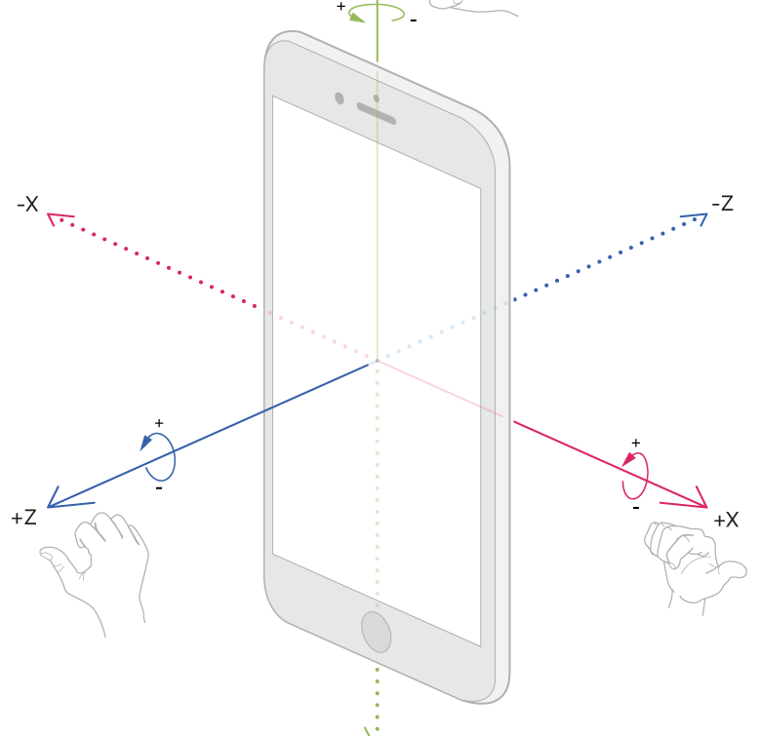
Gyroscope
A gyroscope measures the rate at which a device rotates around a spatial axis. Many iOS devices have a three-axis gyroscope, which delivers rotation values in each of the three axes.
Rotation values are measured in radians per second around the given axis. Rotation values may be positive or negative depending on the direction of rotation.

Slide 17
Gyroscope
You access the raw gyroscope data using the classes of the Core Motion framework. Specifically, the CMMotionManager class provides the interfaces for enabling the gyroscope hardware.
Before enabling that hardware, always check the value of the isGyroAvailable property to verify that the gyroscopes are available for you to use.
When enabling the hardware, choose the interfaces that are best suited for your app. You can pull the gyroscope data only when you need it, or you can ask the framework to push updates to your app at regular intervals.
Each technique involves different configuration steps and has a different use case.

Slide 18
Gyroscope
The raw rotation rate data delivered by the gyroscope interfaces may be biased by other factors such as device acceleration. If your app requires unbiased rotation values, use the device-motion interfaces instead. The device-motion interfaces use special algorithms to remove any bias and deliver more precise rotation values.
For more information, see Getting Processed Device-Motion Data.

Slide 19
Gyro data when needed
For apps that process gyroscope data on their own schedule, such as games, use the startGyroUpdates() method of CMMotionManager to start the delivery of rotation data.
When you call this method, the system enables the gyroscope hardware and begins updating the gyroData property of your CMMotionManager object. However, the system does not notify you when it updates that property.
You must explicitly check the value of the property when you need the rotation data.
self.motion.gyroUpdateInterval = 1.0 / 60.0 self.motion.startGyroUpdates()

Slide 20
Location

Slide 21
Location
Core Location offers three different services for fetching the user's location.
Each service offers different benefits and comes with different power and authorization requirements.
You can use a single service, or you can use multiple services at different times, depending on your needs.

Slide 22
Authorization first
It’s important to take great care with a user’s location data, and the system requires your app to get the user’s authorization to access this kind of information.
To request authorization, call requestWhenInUseAuthorization() or requestAlwaysAuthorization(), depending on the authorization status your app needs.
See Choosing the Location Services Authorization to Request for more information about deciding what type of authorization to request. Your Xcode project must be configured with purpose strings used in the authorization prompts.

Slide 23
Authorization first
To prepare your app for calling requestWhenInUseAuthorization() or requestAlwaysAuthorization(), you must add keys with purpose strings to your app's Info.plist file.
The system displays your purpose strings in the authorization request dialogs. Configure the keys in Xcode with the purpose strings that your app requires.

Slide 24
Authorization first
Consider the context of the user's interactions when you request authorization to use their location.
Request authorization only when your user needs location services to perform a task in your app. If it's not clear to the user why your app is using location services, the user may deny your request.
Don't automatically ask for authorization when your app returns to the foreground. If your app has temporary authorization, it loses it when the user stops using your app. Unless the user expects you to continue using their location, wait until the user needs the location to be updated again before requesting authorization.

Slide 25
Authorization first
Call requestWhenInUseAuthorization() or requestAlwaysAuthorization() to request authorization at the point where you need location services. You may request When In Use authorization as needed; there are no limits on calling requestWhenInUseAuthorization().
The system does limit calls to requestAlwaysAuthorization(); you may request it only one time.

Slide 26
Authorization first
After making an authorization request, it’s safe to start location services before your request resolves.
However, you won't receive location events until your app's authorization status changes to CLAuthorizationStatus.authorizedAlways or CLAuthorizationStatus.authorizedWhenInUse.
Implement the locationManager(_:didChangeAuthorization:) method in your location manager delegate to be notified when your app's authorization status changes.

Slide 27
Visits location service
The most power-efficient way to gather location data. This service delivers location updates when the user has spent time in one location and then moves on. Each update includes both the location and the amount of time spent at that location.
This service is not intended for navigation or other real-time activities. Instead, use it to identify patterns in the user's behavior and apply that knowledge to other parts of your app. For example, a music app might prepare a workout playlist when the user leaves the house and heads to the gym.

Slide 28
Visits location service
To start the visits location service, call the startMonitoringVisits() method of your location manager. With this service, the location manager ignores the values in its distanceFilter and desiredAccuracy properties, so you don’t need to configure them. The location manager delivers updates to the locationManager(_:didVisit:) method of its delegate.
Another way to save power is to set the pausesLocationUpdatesAutomatically property of your location manager object to true. Enabling this property lets the system reduce power consumption by disabling location hardware when the user is unlikely to be moving. Pausing updates doesn’t diminish the quality of those updates, but can improve battery life significantly. To help the system determine when to pause updates, you must also assign an appropriate value to the activityType property of your location manager.

Slide 29
Visits location service
When you start the visits location service, a recently cached value may be reported to your delegate immediately. As new visit data is obtained, the location manager calls your delegate’s locationManager(_:didVisit:) method with the updated value.

Slide 30
Significant-change location service
A power-friendly alternative for apps that need to track the user's location but do not need frequent updates or the precision offered by GPS. This service relies on lower-power alternatives to determine the user's location and delivers updates only when significant changes to that location occur.
You might use this service to deliver suggestions for nearby points of interest when the user is walking.

Slide 31
Standard location service
A configurable, general-purpose solution for getting the user's location in real time. This service uses significantly more power than the other location services, but it delivers the most accurate and immediate location information.
Use this service only when you really need it, such as when offering navigation instructions or when recording a user's path on a hike.

Slide 32

Questions

